Slide 1

Zorua: A Holistic Approach to Resource Virtualization in GPUs
2016 49th Annual IEEE/ACM International Symposium on Microarchitecture (MICRO)
黄爽 S211000791

Slide 2
1.
Introduction
2.
Motivation
CONTENTS
3.
Zorua
4.
Evaluation

Slide 3
Introduction
In order to execute, each GPU thread requires several major on-chip resources: (i)registers,(ii)scratchpad memory(if used in the program), and(iii)a thread slot in the thread scheduler that keeps all the bookkeeping information required for execution.
These resources are statically allocated to threads in the application based on several parameters,which we refer to as the resource specification of the application.
There are only a few optimized resource specifications that maximize resource utilization. Picking a suboptimal specification leads to under-utilization of resources and hence, very often, performance degradation.

Slide 4
Introduction
This leads to three key difficulties related to obtaining good performance on modern GPUs
Programming Ease
In addition to select a specification , the programmer needs to be aware of the details of the GPU architecture to fit the specification to the underlying hardware resources. There are many suboptimal performance points in the specification space, and even a minor deviation can lead to a drastic drop in performance due to lost parallelism.
Portability
Different GPUs have varying quantities of each of the resources. Hence, an optimized specification on one GPU may be highly suboptimal on another .
Performance
Since the program (even after auto-tuning) has tostatically specify its worst-case resource requirements, severe dynamic under- utilizationof several GPU resources ensues,leading to suboptimal performance

Slide 5
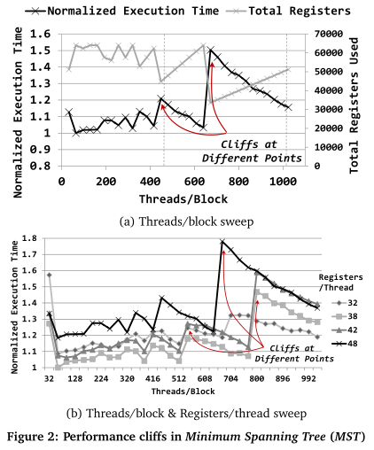
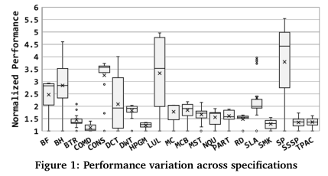
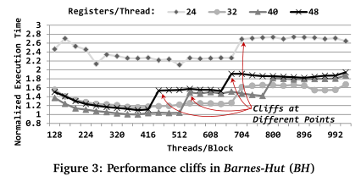
Motivation
Performance Variation and Cliffs

Slide 6
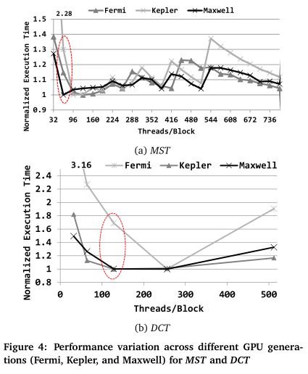
Motivation
Dynamic Resource Underutilization
To determine the magnitude of this dynamic underutilization,we conduct an experiment where we measure the dynamic usage (per epoch) of both scratchpad memory and registers for different applications with optimized specifications in our workload pool. We vary the length of epochs from 500 to 5000 cycles (not graphed). We find that even for a reasonably large epoch of 500 cycles,the average utilization of resources is very low (only 12% of allocated scratchpad memory and 37% of registers are uti-lized). Moreover , even with the largest epoch size we analyze (5000 cycles), the average utilization of allocated scratchpad memory is only 45% and of allocated registers is 68%. This observation clearly suggests that there is an opportunity for better dynamic allocation of these resources that could allow higher effective parallelism.
Portability

Slide 7
Zorua
Zorua:
A framework that provides the illusion of more GPU resources than physically available by decoupling the resource specification from its allocation in the hardware resources.
First,when there are insufficient physical resources, we aim to provide the illusion of the required amount by oversubscribing the required resource. We perform this oversubscription by leveraging the dynamic underutilization as much as possible, or by spilling to a swap space in memory . This oversubscription enables the illusion of more resources than what is available , and supports the concurrent execution of more threads. Performance cliffs are mitigated by providing enough additional resources to avoid drastic drops in parallelism.
Second, to enable efficient over-subscription by leveraging underutilization, we dynamically allocate and deallocate physical resources depending on the requirements of the application during execution.

Slide 8
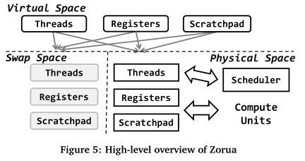
Zorua
The virtual spacerefers to the illusionof the quantity of available resources. The physical spacerefers to the actual hardware resources (specific to the GPU architecture), and theswap spacerefers to the resources that do not fit in the physical space and hence arespilledto other physical locations.For the register file and scratchpad memory, the swap space is mapped to global memory space in the memory hierarchy . For threads, only those that are mapped to the physical space are available for scheduling and execution at any given time. If a thread is mapped to the swap space, its state (i.e., the PC and the SIMT stack) is saved in memory . Resources in the virtual space can be freely re-mapped between the physical and swap spaces to maintain the illusion of the virtual space resources.

Slide 9
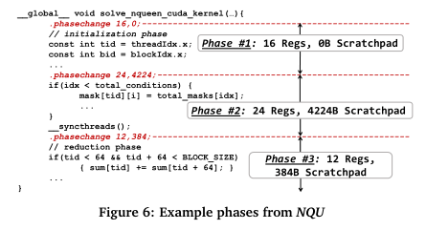
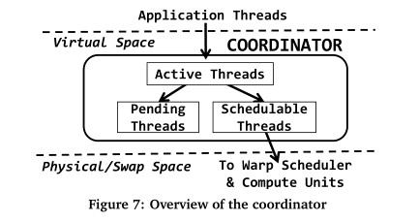
Zorua
Leveraging Software Annotations of Phase Charac-teristics.
Control with an Adaptive Runtime System.

Slide 10
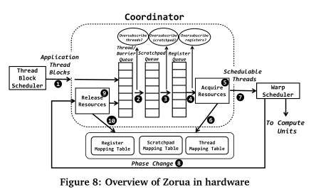
Zorua
Detailed Walkthrough
(i) a new thread block is scheduled at the SM for execution,
(ii) a warp undergoes a phase change,
(iii) a warp or a thread block reaches the end of execution.
Between these events,the coordinator performs no action and execution proceeds as usual.
Thread>scratchpad>register

Slide 11
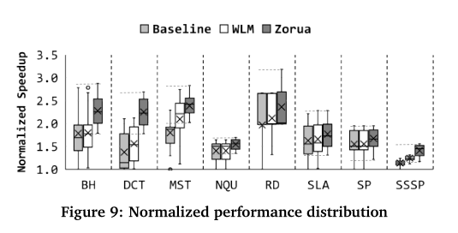
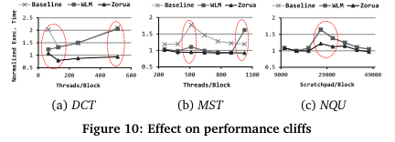
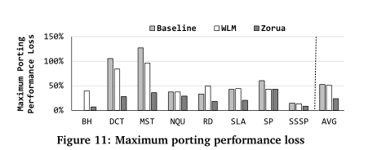
Evaluation
Baseline/Zorua/WLM

